Slide 1
Simple Calculator

Slide 2
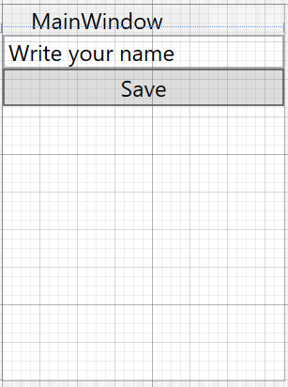
XAML
EXtensible Application Markup Language
StackPanel: is a layout panel that arranges child elements into a single block.
<Grid>
<StackPanel>
<TextBox Text="Write your name"/>
<Button Content="Save" x:Name="saveButton"/>
</StackPanel>
</Grid>
Element
Properties

Slide 3
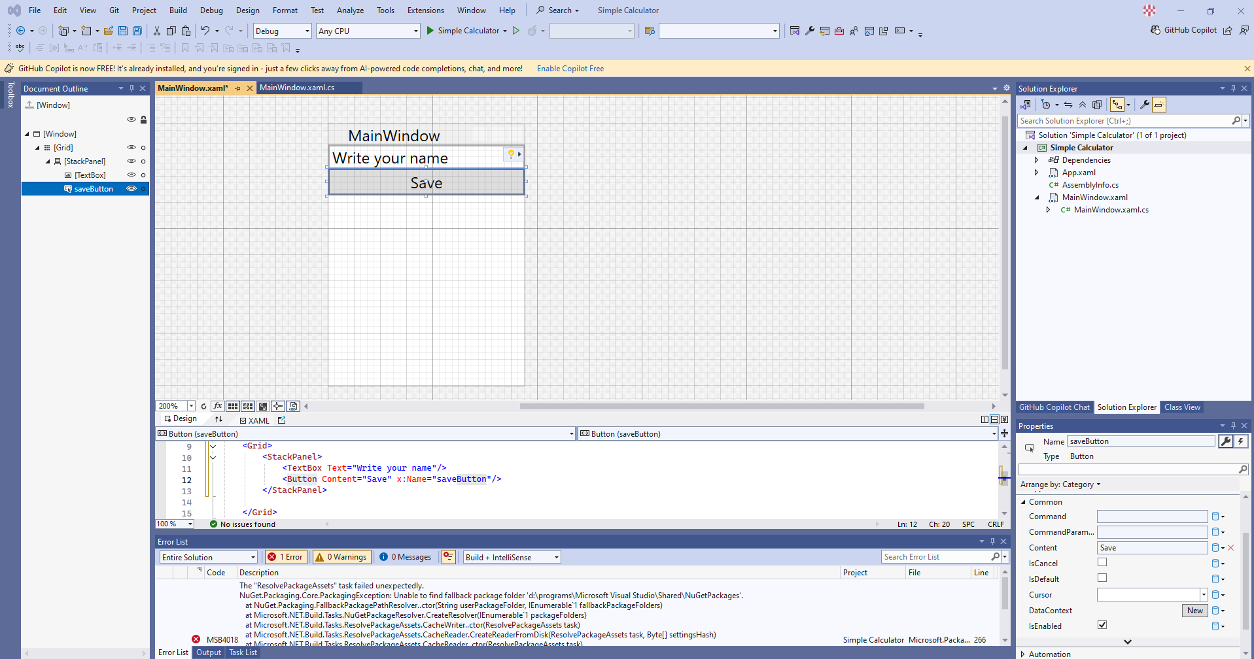

Slide 4
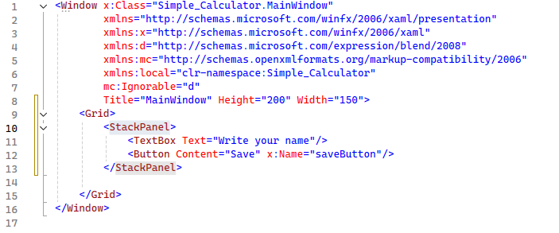
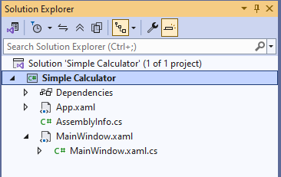
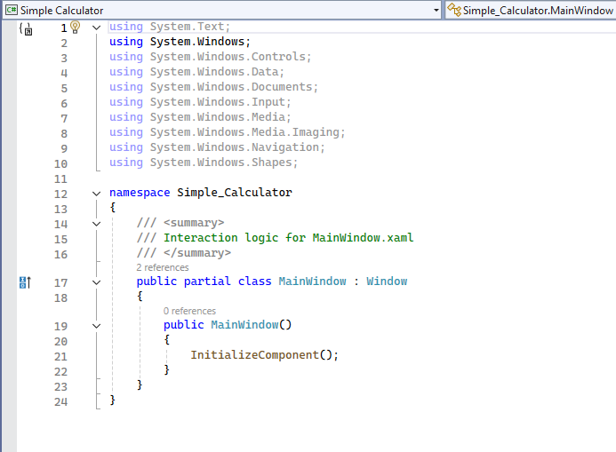
<Window x:Class="Simple_Calculator.MainWindow"
xmlns="http://schemas.microsoft.com/winfx/2006/xaml/presentation"
xmlns:x="http://schemas.microsoft.com/winfx/2006/xaml"
xmlns:d="http://schemas.microsoft.com/expression/blend/2008"
xmlns:mc="http://schemas.openxmlformats.org/markup-compatibility/2006"
xmlns:local="clr-namespace:Simple_Calculator"
mc:Ignorable="d"
Title="MainWindow" Height="200" Width="150">
<Grid>
<StackPanel>
<TextBox Text="Write your name"/>
<Button Content="Save" x:Name="saveButton"/>
</StackPanel>
</Grid>
</Window>
Code behind the file
Linked through the class definition with the same name c# file
XAML and C# both define same partial class.
using System.Text;
using System.Windows;
using System.Windows.Controls;
using System.Windows.Data;
using System.Windows.Documents;
using System.Windows.Input;
using System.Windows.Media;
using System.Windows.Media.Imaging;
using System.Windows.Navigation;
using System.Windows.Shapes;
namespace Simple_Calculator
{
/// <summary>
/// Interaction logic for MainWindow.xaml
/// </summary>
public partial class MainWindow : Window
{
public MainWindow()
{
InitializeComponent();
}
}
}

Slide 5
Some features:
Familiar to HTML/XML users
Powerful binding for better designer/developer cooperation

Slide 6
XAML syntax
Defining namespaces
<Window x:Class="Simple_Calculator.MainWindow"
xmlns="http://schemas.microsoft.com/winfx/2006/xaml/presentation"
xmlns:x="http://schemas.microsoft.com/winfx/2006/xaml"
xmlns:d="http://schemas.microsoft.com/expression/blend/2008"
xmlns:mc="http://schemas.openxmlformats.org/markup-compatibility/2006"
xmlns:local="clr-namespace:Simple_Calculator"
mc:Ignorable="d"
Title="MainWindow" Height="200" Width="150">
<Grid>
</Grid>
</Window>

Slide 7
Define element in Grid
<StackPanel>
</StackPanel>
Opening tag
Closing tag
<Label/>
Single line elements needs to be finished />

Slide 8
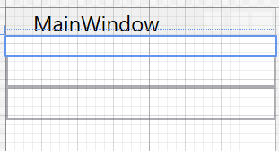
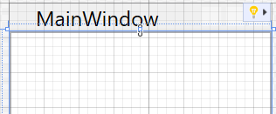
<StackPanel>
<Label/>
<TextBox/>
<TextBox/>
</StackPanel>
<Label/>
<TextBox/>
<TextBox/>

Slide 9
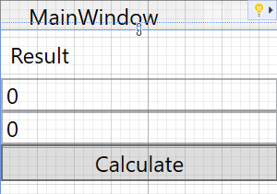
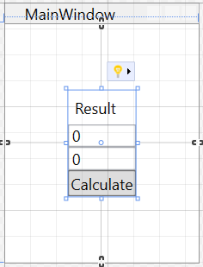
<StackPanel>
<Label Content="Result"/>
<TextBox Text="0"/>
<TextBox Text="0"/>
<Button Content="Calculate"/>
</StackPanel>
<StackPanel VerticalAlignment="Center"
HorizontalAlignment="Center">
<Label Content="Result"/>
<TextBox Text="0"/>
<TextBox Text="0"/>
<Button Content="Calculate"/>
</StackPanel>
Remove Horizontal alignment and apply margins

Slide 10
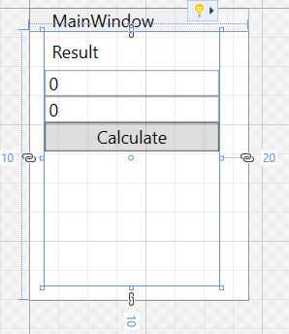
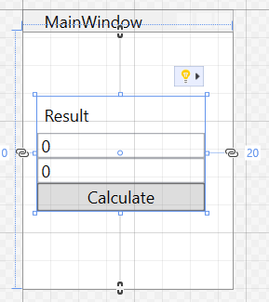
Margin="10, 0, 20, 10
<StackPanel VerticalAlignment="Center"
Margin="10, 0, 20, 10">
Left
top
Right
Bottom
Margin="10, 10"

Slide 11
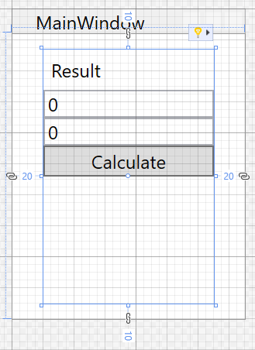
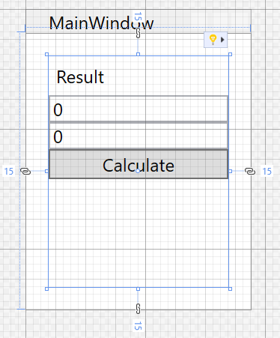
Margin="10, 10"
Margin="10"

Slide 12
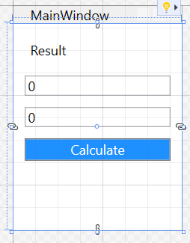
<StackPanel
Margin="10">
<Label Content="Result"
Margin="0,0,0,10"/>
<TextBox Text="0"
Margin="0,0,0,10"/>
<TextBox Text="0"
Margin="0,0,0, 10"/>
<Button Content="Calculate"
Background="DodgerBlue"
Foreground="white"/>
</StackPanel>

Slide 13
Grid element
<Grid Margin="10">
<Grid.Margin></Grid.Margin>
These are equivalent definitions
Value
<Grid.ColumnDefinitions>
<ColumnDefinition Width="123"/>
</Grid.ColumnDefinitions>
<Grid.ColumnDefinitions>
<ColumnDefinition Width="auto"/>
</Grid.ColumnDefinitions>
Use only space it needs
Uses all available space
<Grid.ColumnDefinitions>
<ColumnDefinition Width="*"/>
</Grid.ColumnDefinitions>

Slide 14
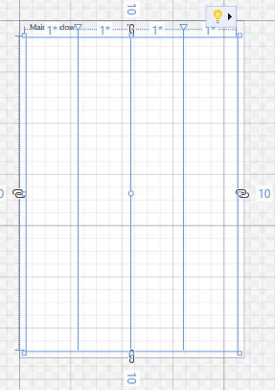
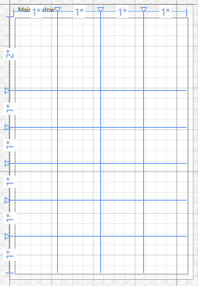
<Grid.ColumnDefinitions>
<ColumnDefinition Width="*"/>
<ColumnDefinition Width="*"/>
<ColumnDefinition Width="*"/>
<ColumnDefinition Width="*"/>
</Grid.ColumnDefinitions>
<Grid.RowDefinitions>
<RowDefinition Height="2*"/>
<RowDefinition Height="*"/>
<RowDefinition Height="*"/>
<RowDefinition Height="*"/>
<RowDefinition Height="*"/>
<RowDefinition Height="*"/>
</Grid.RowDefinitions>

Slide 15
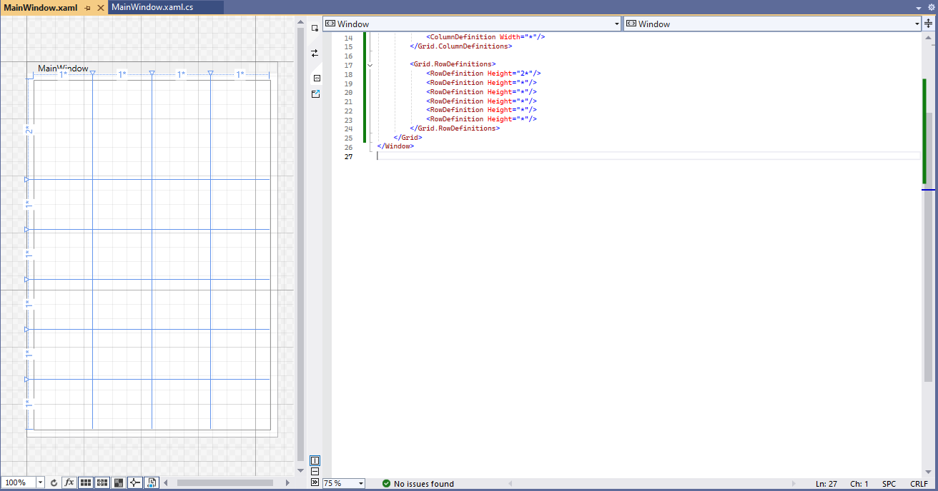

Slide 16
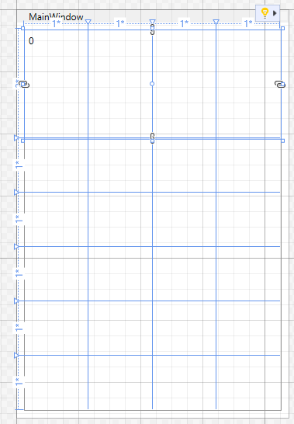
<Label Content="0"
Grid.ColumnSpan="4"/>

Slide 17
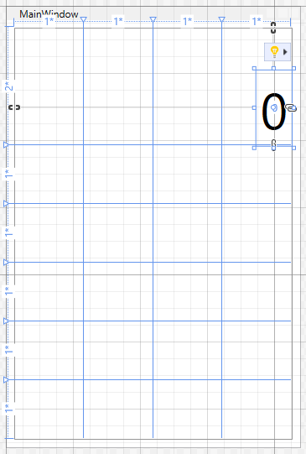
<Label Content="0"
Grid.ColumnSpan="4"
HorizontalAlignment="Right"
VerticalAlignment="Bottom"
FontSize="60"/>

Slide 18
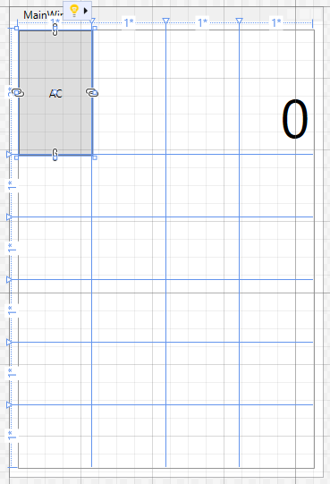
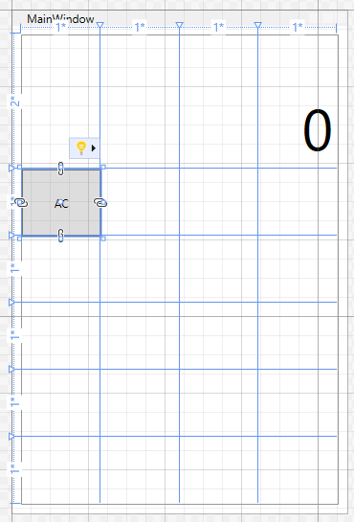
Add button
<Button Content="AC"/>
<Button Content="AC"
Grid.Row="1"/>

Slide 19
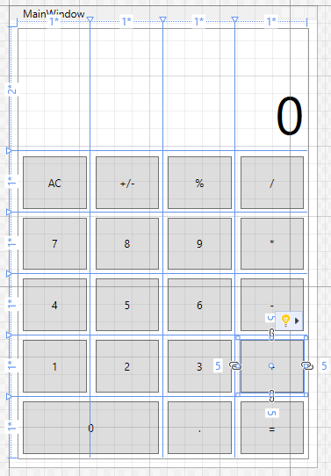
Now define all the remaining buttons as shown in the picture
In case of “0” button this shall be spanned over two grid columns, do you know how to do this?

Slide 20
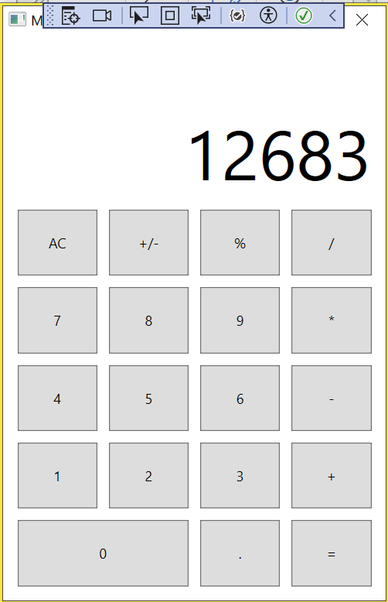
Communication with code behind
To access the XAML component we need to give it a name:
This property is in x namespace and defines name for the element.
<Label x:Name="resultLabel"
Content="0"
Grid.ColumnSpan="4"
HorizontalAlignment="Right"
VerticalAlignment="Bottom"
FontSize="60"/>
public Window1()
{
InitializeComponent();
resultLabel.Content = “12683";
}
Add names to all the Buttons.

Slide 21
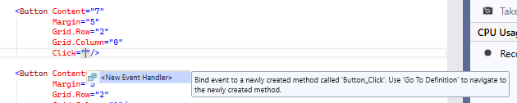
public partial class MainWindow : Window
{
public MainWindow()
{
InitializeComponent();
}
private void Button_Click(object sender, RoutedEventArgs e)
{
}
}

Slide 22
Add logic to add number 7 to the resultLabel textbox output.
See $ syntax for string. This allows to use the variable in {} within the quotes.
private void Button_Click(object sender, RoutedEventArgs e)
{
if (resultLabel.Content.ToString() == "0")
resultLabel.Content = "7";
else
resultLabel.Content += $"{resultLabel.Content}7";
}

Slide 23
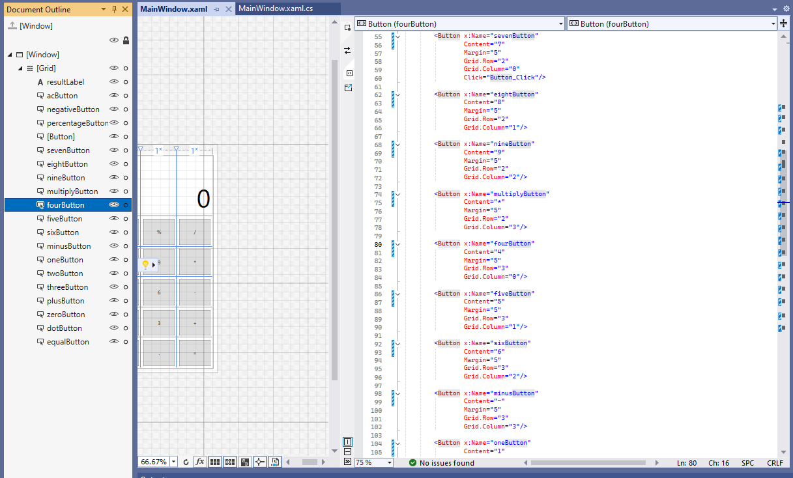

Slide 24
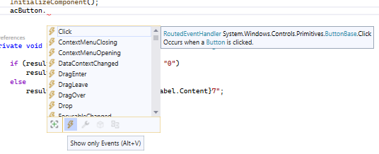

Create a new Event handler directly from C#
public MainWindow()
{
InitializeComponent();
acButton.Click += AcButton_Click;
}
private void AcButton_Click(object sender, RoutedEventArgs e)
{
throw new NotImplementedException();
}
Remove the exception which would cause the app to crash

Slide 25
private void AcButton_Click(object sender, RoutedEventArgs e)
{
resultLabel.Content = "0";
}
Now create a new event handler for negativButton click. Use the same method as for acButton.
public MainWindow()
{
InitializeComponent();
acButton.Click += AcButton_Click;
negativeButton.Click += NegativeButton_Click;
}
private void NegativeButton_Click(object sender, RoutedEventArgs e)
{
}

Slide 26
public partial class MainWindow : Window
{
double lastNumber, result;
public MainWindow()
...
private void NegativeButton_Click(object sender, RoutedEventArgs e)
{
if (double.TryParse(resultLabel.Content.ToString(), out lastNumber))
{
lastNumber = lastNumber * -1;
resultLabel.Content = lastNumber.ToString();
}
}

Slide 27
public MainWindow()
{
InitializeComponent();
acButton.Click += AcButton_Click;
negativeButton.Click += NegativeButton_Click;
percentageButton.Click += PercentageButton_Click;
}
private void PercentageButton_Click(object sender, RoutedEventArgs e)
{
if (double.TryParse(resultLabel.Content.ToString(), out lastNumber))
{
lastNumber = lastNumber / 100;
resultLabel.Content = lastNumber.ToString();
}
}

Slide 28
Change sevenButton_Click to NumberButton_Click
private void NumberButton_Click(object sender, RoutedEventArgs e)
{
if (resultLabel.Content.ToString() == "0")
resultLabel.Content = "7";
else
resultLabel.Content += $"{resultLabel.Content}7";
}
Then add the event handler to all number buttons.
Click="NumberButton_Click"

Slide 29
private void NumberButton_Click(object sender, RoutedEventArgs e)
{
int selectedValue = 0;
if (sender == zeroButton)
selectedValue = 0;
else if (sender == oneButton)
selectedValue = 1;
else if (sender == twoButton)
selectedValue = 2;
else if (sender == threeButton)
selectedValue = 3;
else if (sender == fourButton)
selectedValue = 4;
else if (sender == fiveButton)
selectedValue = 5;
else if (sender == sixButton)
selectedValue = 6;
else if (sender == sevenButton)
selectedValue = 7;
else if (sender == eightButton)
selectedValue = 8;
else if (sender == nineButton)
selectedValue = 9;
if (resultLabel.Content.ToString() == "7")
resultLabel.Content = $"{selectedValue}";
else
resultLabel.Content += $"{resultLabel.Content}{selectedValue}";
}
Evaluate the sender info
Change the evaluation to check the
Assign the selectedValue

Slide 30
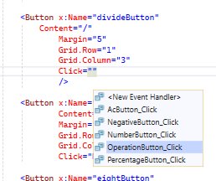
Create a new event handler in C#
private void OperationButton_Click(object sender, RoutedEventArgs e)
{
}
When in XAML

Slide 31
int selectedValue = int.Parse( ((Button)sender).Content.ToString() ); // alternative to (Button)sender is (sender as Button)
/* ((Button)sender).Content
if (sender == zeroButton)
selectedValue = 0;
else if (sender == oneButton)
selectedValue = 1;
else if (sender == twoButton)
selectedValue = 2;
else if (sender == threeButton)
selectedValue = 3;
else if (sender == fourButton)
selectedValue = 4;
else if (sender == fiveButton)
selectedValue = 5;
else if (sender == sixButton)
selectedValue = 6;
else if (sender == sevenButton)
selectedValue = 7;
else if (sender == eightButton)
selectedValue = 8;
else if (sender == nineButton)
selectedValue = 9;
*/
if (resultLabel.Content.ToString() == "0")
resultLabel.Content = $"{selectedValue}";
else
resultLabel.Content = $"{resultLabel.Content}{selectedValue}";
}
Refactored the numberButton_Click and used the sender as Button)
Remember that (Button)sender – parsing is equivalent to
(sender as Button).

Slide 32
Custom types
New type of enum (enumerator)
public enum SelectedOperator
{
Addition,
Substruction,
Multiplication,
Division
}
public partial class MainWindow : Window
{
double lastNumber, result;
SelectedOperator selectedOperator;
if (sender == multiplyButton)
selectedOperator = SelectedOperator.Multiplication;
else if (sender == divideButton)
selectedOperator = SelectedOperator.Division;
else if (sender == minusButton)
selectedOperator = SelectedOperator.Substruction;
else if (sender == plusButton)
selectedOperator = SelectedOperator.Addition;

Slide 33
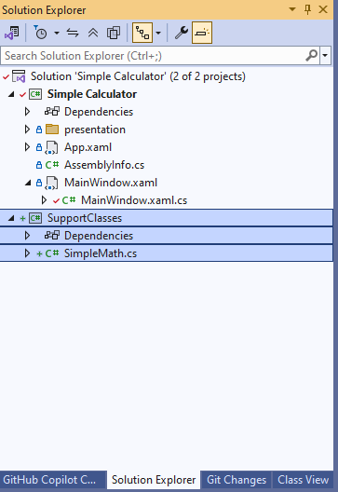
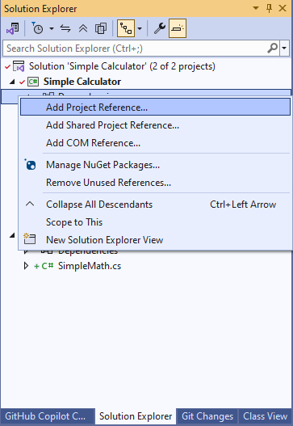
Create a new project of type: Class Library
Call it SupportClasses
Create a class SimpleMath

Slide 34
namespace SupportClasses
{
public class SimpleMath
{
public static double Add(double n1, double n2)
{
return n1 + n2;
}
public static double Subtract(double n1, double n2)
{
return n1 - n2;
}
public static double Multiply(double n1, double n2)
{
return (n1 * n2);
}
public static double Divide(double n1, double n2)
{
return (n1 / n2);
}
}
}

Slide 35
Implementing the SimpleMath class:
public MainWindow()
{
InitializeComponent();
acButton.Click += AcButton_Click;
negativeButton.Click += NegativeButton_Click;
percentageButton.Click += PercentageButton_Click;
equalButton.Click += EqualButton_Click;
}
private void EqualButton_Click(object sender, RoutedEventArgs e)
{
double newNumber;
if (double.TryParse(resultLabel.Content.ToString(), out newNumber))
{
switch (selectedOperator)
{
case SelectedOperator.Addition:
result = SupportClasses.SimpleMath.Add(lastNumber, newNumber);
break;
case SelectedOperator.Substruction:
break;
case SelectedOperator.Multiplication:
break;
case SelectedOperator.Division:
break;
default:
break;
}
}
}

Slide 36
Add dot click handler
<Button x:Name="dotButton"
Content="."
Margin="5"
Grid.Row="5"
Grid.Column="2"
Click="dotButton_Click"/>
private void dotButton_Click(object sender, RoutedEventArgs e)
{
if (resultLabel.Content.ToString().Contains("."))
{
// Do nothing
}
resultLabel.Content = $"{resultLabel.Content}.";
}

Slide 37
MessageBox :
case SelectedOperator.Division:
if (SupportClasses.SimpleMath.Divide(lastNumber, newNumber, out result) == 999)
{
MessageBox.Show("Division by 0 is not supported", "Wrong operation", MessageBoxButton.OK, MessageBoxImage.Error);
}
break;
public static int Divide(double n1, double n2, out double result)
{
if (n2 == 0)
{
result = 0;
return 999;
}
else
result = (n1 / n2);
return 0;
}

Slide 38
STYLES

Slide 39
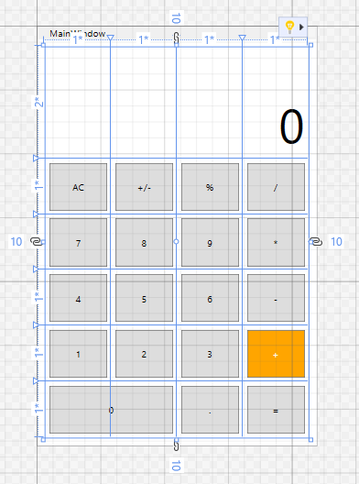
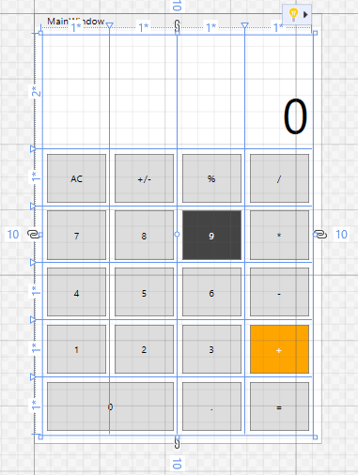
<Button x:Name="plusButton"
Content="+"
Margin="5"
Grid.Row="4"
Grid.Column="3"
Click="OperationButton_Click"
Background="Orange"
Foreground="White"/>
<Button x:Name="nineButton"
Content="9"
Margin="5"
Grid.Row="2"
Grid.Column="2"
Click="NumberButton_Click"
Background="#444444"
Foreground="white"/>

Slide 40
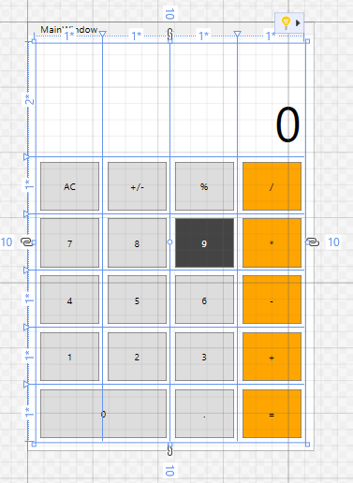
<!-- Operation buttons -->
<Button x:Name="plusButton"
Content="+"
Margin="5"
Grid.Row="4"
Grid.Column="3"
Click="OperationButton_Click"
Background="{StaticResource operatorColor}"/>
<Button x:Name="minusButton"
Content="-"
Margin="5"
Grid.Row="3"
Grid.Column="3"
Click="OperationButton_Click"
Background="{StaticResource operatorColor}"/>
<Button x:Name="multiplyButton"
Content="*"
Margin="5"
Grid.Row="2"
Grid.Column="3"
Click="OperationButton_Click"
Background="{StaticResource operatorColor}"/>
<Button x:Name="divideButton"
Content="/"
Margin="5"
Grid.Row="1"
Grid.Column="3"
Click="OperationButton_Click"
Background="{StaticResource operatorColor}"/>
<Button x:Name="equalButton"
Content="="
Margin="5"
Grid.Row="5"
Grid.Column="4"
Background="{StaticResource operatorColor}"/>
Static Resources:
<Window x:Class="Simple_Calculator.MainWindow"
xmlns="http://schemas.microsoft.com/winfx/2006/xaml/presentation"
xmlns:x="http://schemas.microsoft.com/winfx/2006/xaml"
xmlns:d="http://schemas.microsoft.com/expression/blend/2008"
xmlns:mc="http://schemas.openxmlformats.org/markup-compatibility/2006"
xmlns:local="clr-namespace:Simple_Calculator"
mc:Ignorable="d"
Title="MainWindow" Height="525" Width="350">
<Window.Resources>
<SolidColorBrush x:Key="numbersColor" Color="#444444"/>
<SolidColorBrush x:Key="operatorColor" Color="orange"/>
</Window.Resources>
<Grid Margin="10">

Slide 41
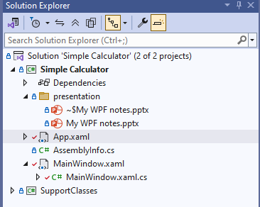
Application wide resources
<Application x:Class="Simple_Calculator.App"
xmlns="http://schemas.microsoft.com/winfx/2006/xaml/presentation"
xmlns:x="http://schemas.microsoft.com/winfx/2006/xaml"
xmlns:local="clr-namespace:Simple_Calculator"
StartupUri="MainWindow.xaml">
<Application.Resources>
<SolidColorBrush x:Key="numbersColor" Color="#666666"/>
<SolidColorBrush x:Key="operatorColor" Color="Green"/>
</Application.Resources>
</Application>

Slide 42
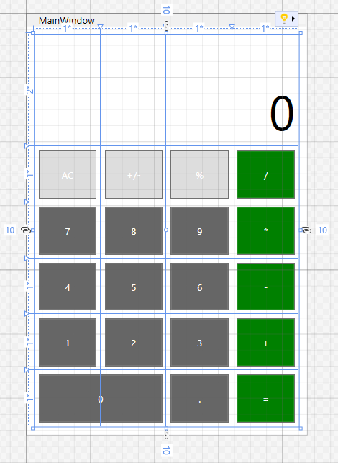
Implicit styles
- Defing foreground for all buttons.
<Application x:Class="Simple_Calculator.App"
xmlns="http://schemas.microsoft.com/winfx/2006/xaml/presentation"
xmlns:x="http://schemas.microsoft.com/winfx/2006/xaml"
xmlns:local="clr-namespace:Simple_Calculator"
StartupUri="MainWindow.xaml">
<Application.Resources>
<SolidColorBrush x:Key="numbersColor" Color="#666666"/>
<SolidColorBrush x:Key="operatorColor" Color="Green"/>
<SolidColorBrush x:Key="foregroundColor" Color="white"/>
<Style TargetType="Button">
<Setter Property="Foreground" Value="White"/>
</Style>
</Application.Resources>
</Application>
Use the implicit style size to increase the fontsize of all buttons to 24.
Override the color of the text for three buttons which look to light.

Slide 43
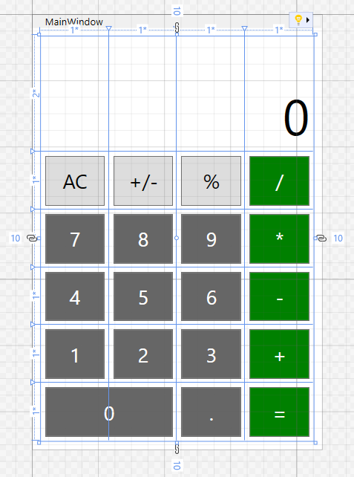
MainWindow.xaml
App.xaml
<Button x:Name="percentageButton"
Content="%"
Margin="5"
Grid.Row="1"
Grid.Column="2"
Foreground="Black"/>
<Style TargetType="Button">
<Setter Property="Foreground" Value="White"/>
<Setter Property="FontSize" Value="24"/>
</Style>

Slide 44
Create an additional style for label to set fontsize to 70
Do not forget to remove the override in the Label definition
<Application.Resources>
<SolidColorBrush x:Key="numbersColor" Color="#666666"/>
<SolidColorBrush x:Key="operatorColor" Color="Green"/>
<SolidColorBrush x:Key="foregroundColor" Color="white"/>
<Style TargetType="Button">
<Setter Property="Foreground" Value="White"/>
<Setter Property="FontSize" Value="24"/>
</Style>
<Style TargetType="Label">
<Setter Property="FontSize" Value="70"/>
</Style>
</Application.Resources>

Slide 45
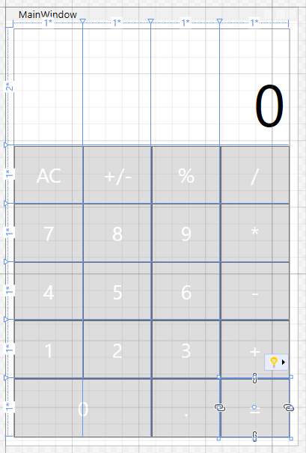
What else can be improved by implicit styles?
<Button x:Name="zeroButton"
Content="0"
Margin="5"
Grid.Row="5"
Grid.Column="0"
Grid.ColumnSpan="2"
Click="NumberButton_Click"
Background="{StaticResource numbersColor}"/>
All buttons have the same Margin.
You can remove the definition from the button and define this is the implicit style for Buttons
Additionally, remove all the background and foreground colors if they are defined. We will learn how to define this with styles in next steps.

Slide 46
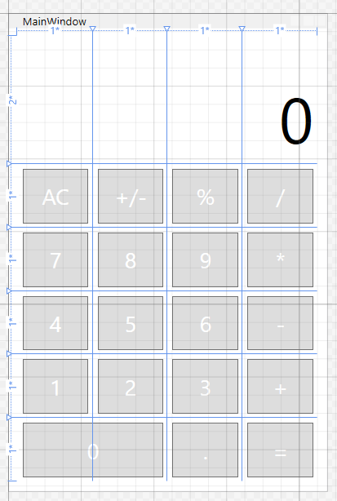
App.xaml
<Style TargetType="Button">
<Setter Property="Foreground" Value="White"/>
<Setter Property="FontSize" Value="24"/>
<Setter Property="Margin" Value="5"/>
</Style>

Slide 47
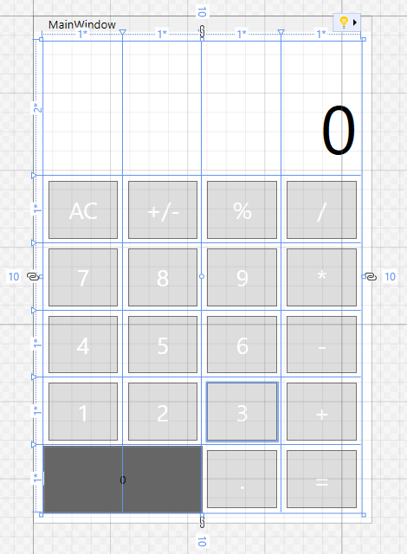
Explicit styles
Add a key to the style
<Style TargetType="Button" x:Key="numberButtonStyle">
<Setter Property="Background" Value="{StaticResource numbersColor}"/>
</Style>
Note that we now use the staticResource defined before.
<Button x:Name="zeroButton"
Content="0"
Grid.Row="5"
Grid.Column="0"
Grid.ColumnSpan="2"
Click="NumberButton_Click"
Style="{StaticResource numberButtonStyle}"/>
The new explicit style is applied to the button “0”. However, the implicit style is overridden and therefore its values are removed.

Slide 48
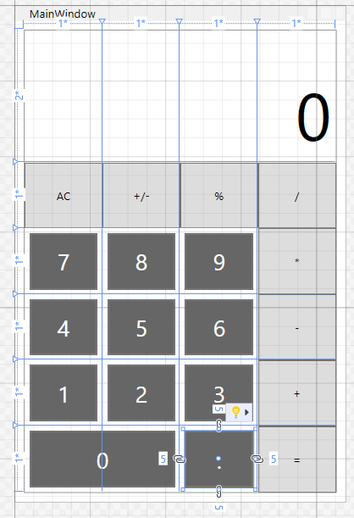
Add a key to the original implicit style
<Style TargetType="Button" x:Key="buttonStyle">
<Setter Property="Foreground" Value="White"/>
<Setter Property="FontSize" Value="24"/>
<Setter Property="Margin" Value="5"/>
</Style>
<Style TargetType="Button" x:Key="numberButtonStyle" BasedOn="{StaticResource buttonStyle}">
<Setter Property="Background" Value="{StaticResource numbersColor}"/>
</Style>
Apply the numberButtonStyle to all numberButtons.
Define new explicit styles for the operation buttons too.
Create a style for the three special buttons too.

Slide 49
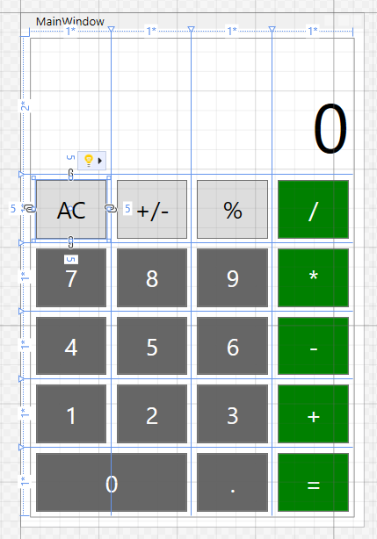
<Style TargetType="Button" x:Key="numberButtonStyle" BasedOn="{StaticResource baseButtonStyle}">
<Setter Property="Background" Value="{StaticResource numbersColor}"/>
</Style>
<Style TargetType="Button" x:Key="operationButtonStyle" BasedOn="{StaticResource baseButtonStyle}">
<Setter Property="Background" Value="{StaticResource operatorColor}"/>
</Style>
<Style TargetType="Button" x:Key="additionalButtonsStyle" BasedOn="{StaticResource baseButtonStyle}">
<Setter Property="Foreground" Value="Black"/>
</Style>

Slide 50
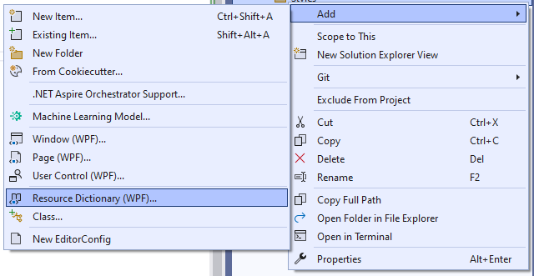

Slide 51
In the new resource file create the following styles. These can be copied from the App.xaml.
This also has a new implicit style for the buttons which is based on the baseButtonStyle. It is a good practice to create an implicit style too.
Note the comments. These have standard xml comment format starting with <!– and finishing with -->.
<ResourceDictionary xmlns="http://schemas.microsoft.com/winfx/2006/xaml/presentation"
xmlns:x="http://schemas.microsoft.com/winfx/2006/xaml">
<!-- These are setters for the colors -->
<SolidColorBrush x:Key="numbersColor" Color="#666666"/>
<SolidColorBrush x:Key="operatorColor" Color="Green"/>
<SolidColorBrush x:Key="foregroundColor" Color="white"/>
<!-- This is the button base style. It shall be used as a base for all other explicit styles -->
<Style TargetType="Button" x:Key="baseButtonStyle">
<Setter Property="Foreground" Value="White"/>
<Setter Property="FontSize" Value="24"/>
<Setter Property="Margin" Value="5"/>
</Style>
<!-- Implicit style which is to be applied if no specific explicit style is applied -->
<Style TargetType="Button" BasedOn="{StaticResource baseButtonStyle}"/>
<!-- Specific button styles -->
<Style TargetType="Button" x:Key="numberButtonStyle" BasedOn="{StaticResource baseButtonStyle}">
<Setter Property="Background" Value="{StaticResource numbersColor}"/>
</Style>
<Style TargetType="Button" x:Key="operationButtonStyle" BasedOn="{StaticResource baseButtonStyle}">
<Setter Property="Background" Value="{StaticResource operatorColor}"/>
</Style>
<Style TargetType="Button" x:Key="additionalButtonsStyle" BasedOn="{StaticResource baseButtonStyle}">
<Setter Property="Foreground" Value="Black"/>
</Style>
</ResourceDictionary>

Slide 52
In app.xaml remove all the resources (brushcolors and styles) which you had copied to the new resource file.
Then create a new ResourceDictionary within Application.Resources.
Use ResourceDictionary.MargedDictionaries to add link to the resource source file.
Then move the remaining resources (Label type) into the Reseource dictionary.
You can check that your MainWindow still looks same as before. However, using the resource dictionaries in this way will help you with larger and more complex applications to be clearer.
<Application.Resources>
<ResourceDictionary>
<ResourceDictionary.MergedDictionaries>
<ResourceDictionary Source="/Styles/ButtonStyles.xaml"/>
</ResourceDictionary.MergedDictionaries>
<Style TargetType="Label">
<Setter Property="FontSize" Value="70"/>
</Style>
</ResourceDictionary>
</Application.Resources>

Slide 53
Here's a breakdown of the process:
Create a Unit Test Project: In Visual Studio, add a new MSTest Test Project to your solution.
Add a Project Reference: Add a reference from your unit test project to the WPF project (or the library containing the view models).
Write Unit Tests: Create unit tests within your test project to verify the functionality of your view model classes. Use the [TestMethod] attribute to mark your test methods.
Run Tests: Run your tests from the Test Explorer in Visual Studio.
Mocking Dependencies: When testing view models that interact with external dependencies (like data access layers, services, etc.), use mocking frameworks (like Moq) to isolate the view model and test its core logic.
UI Testing: While MS Test can't directly test the UI, consider using WinAppDriver or other UI testing frameworks for testing the visual elements of your WPF application.

Slide 54
Debug.Print("New message");

